Slide 1
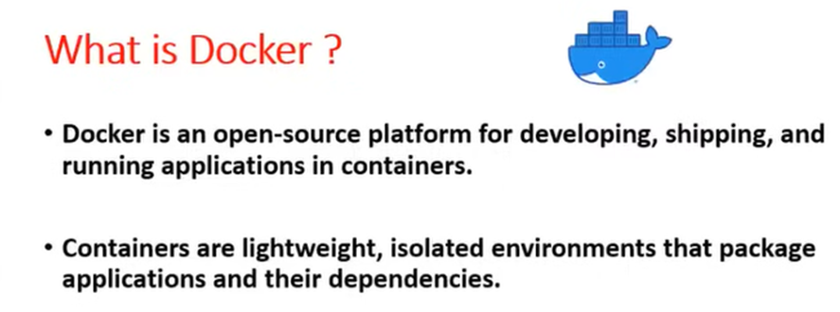

Slide 2
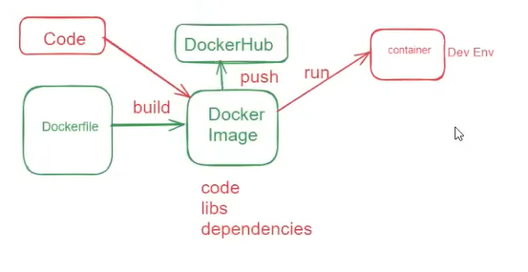

Slide 3
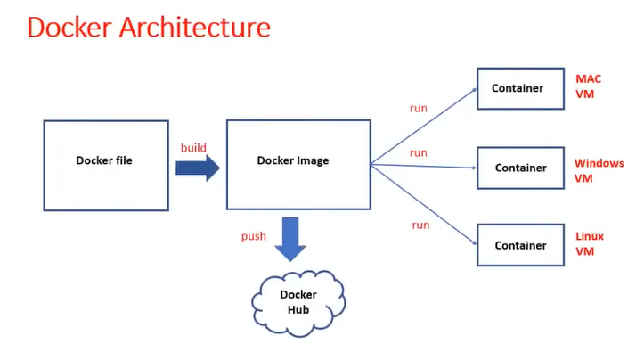

Slide 4
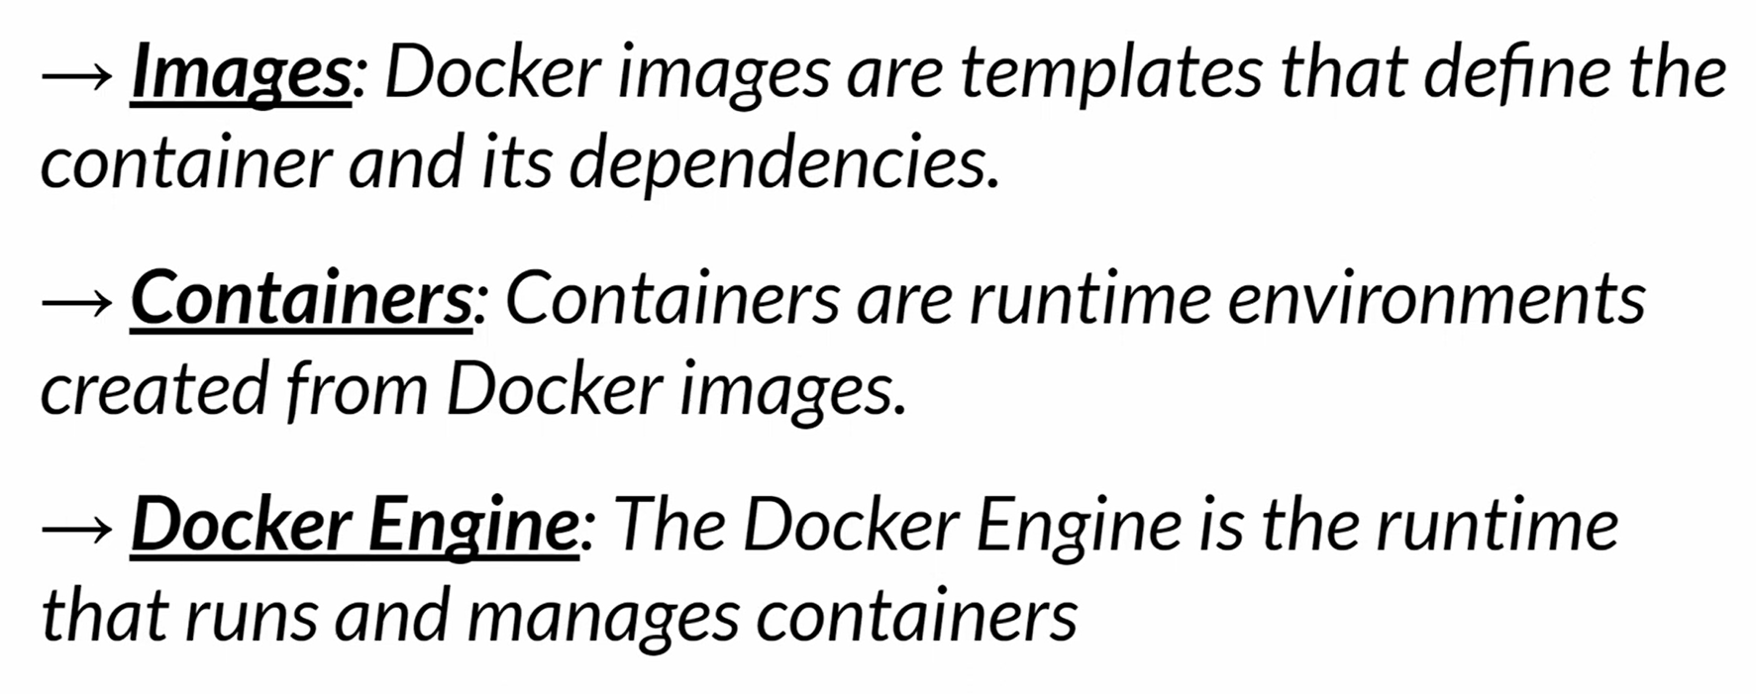

Slide 5
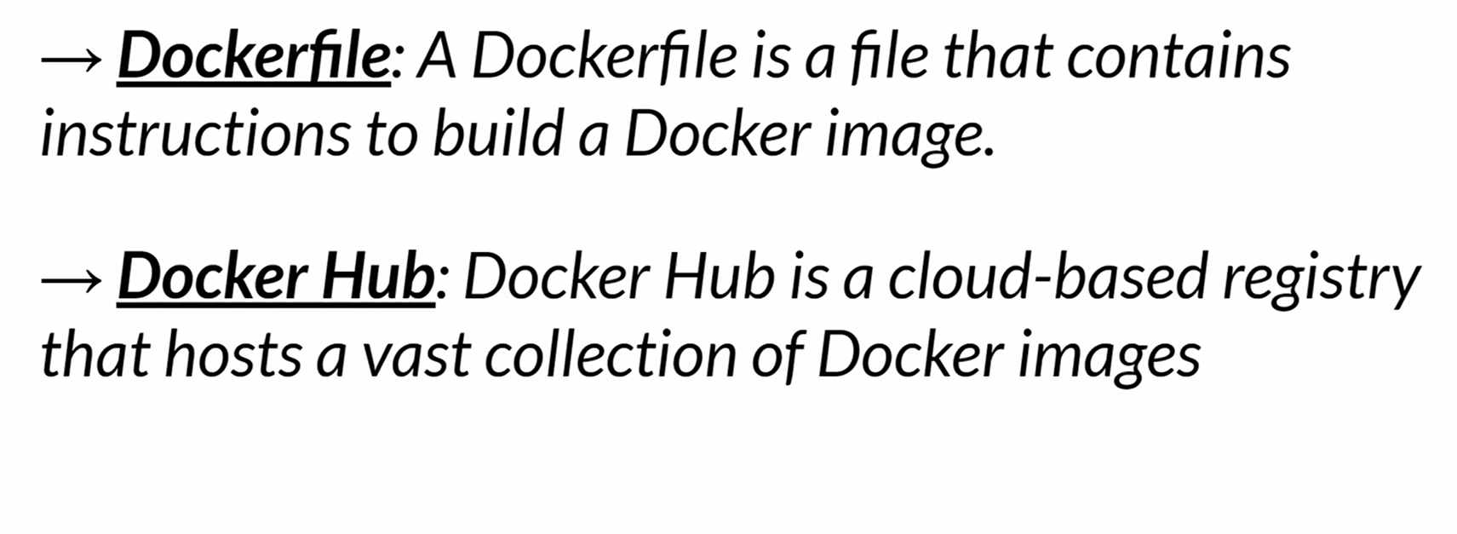

Slide 6
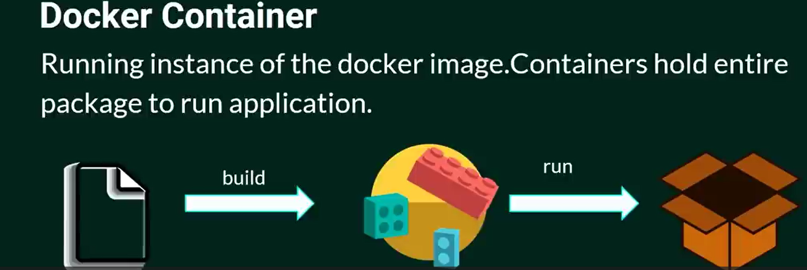
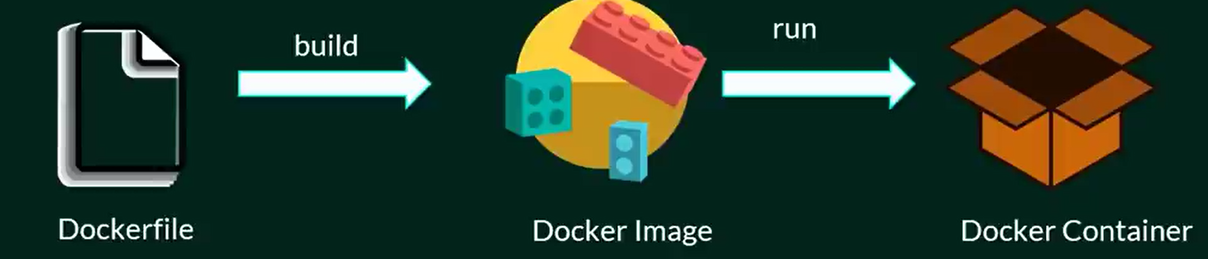

Slide 7
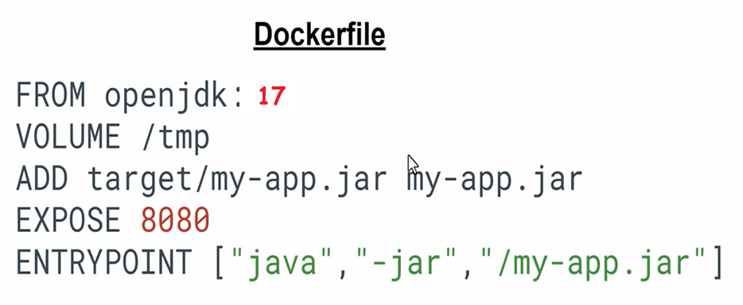
What are the common instructions in a Dockerfile?
FROM: Base image
RUN: Execute command during build
CMD: Default command to run
COPY / ADD: Copy files
WORKDIR: Set working directory

Slide 8
1. How do you create a Docker image?
Ans: docker build -t <image-name> .
2. How do you list all images and containers?
Ans: docker images,
docker ps -a
3. How do you create a Docker container from an image?
Ans: docker run <image-name>
4. How do you check running containers?
Ans: docker ps
How do you stop, start, and remove a container?
Ans:
docker stop <container-id>
docker start <container-id>
docker rm <container-id>

Slide 9
docker –version – Show Docker version
docker info – Show system-wide Docker info
docker images – List all local images
docker pull <image> – Download an image
docker build -t <name>:<tag> . – Build an image from a Dockerfile
docker rmi <image> – Remove an image
docker ps – List running containers
docker ps -a – List all containers (including stopped)
What is the difference between a Docker image and a Docker container?
An image is a blueprint (read-only template) for creating containers.
A container is a running instance of an image.

Slide 10
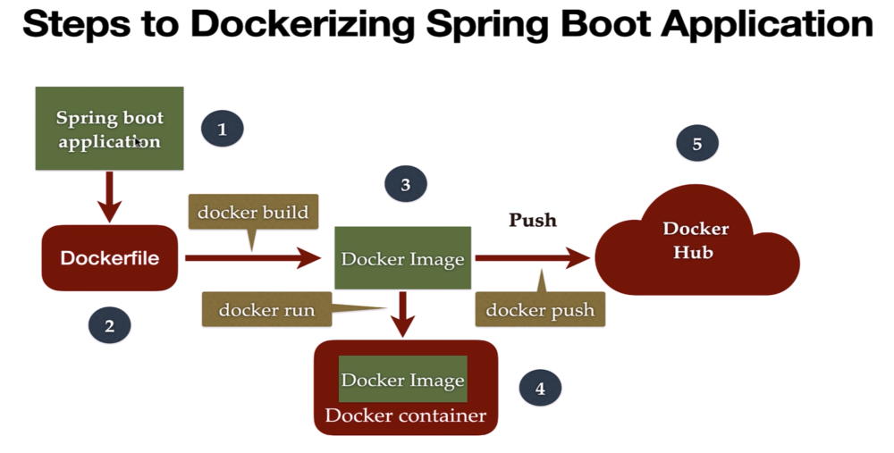

Slide 12
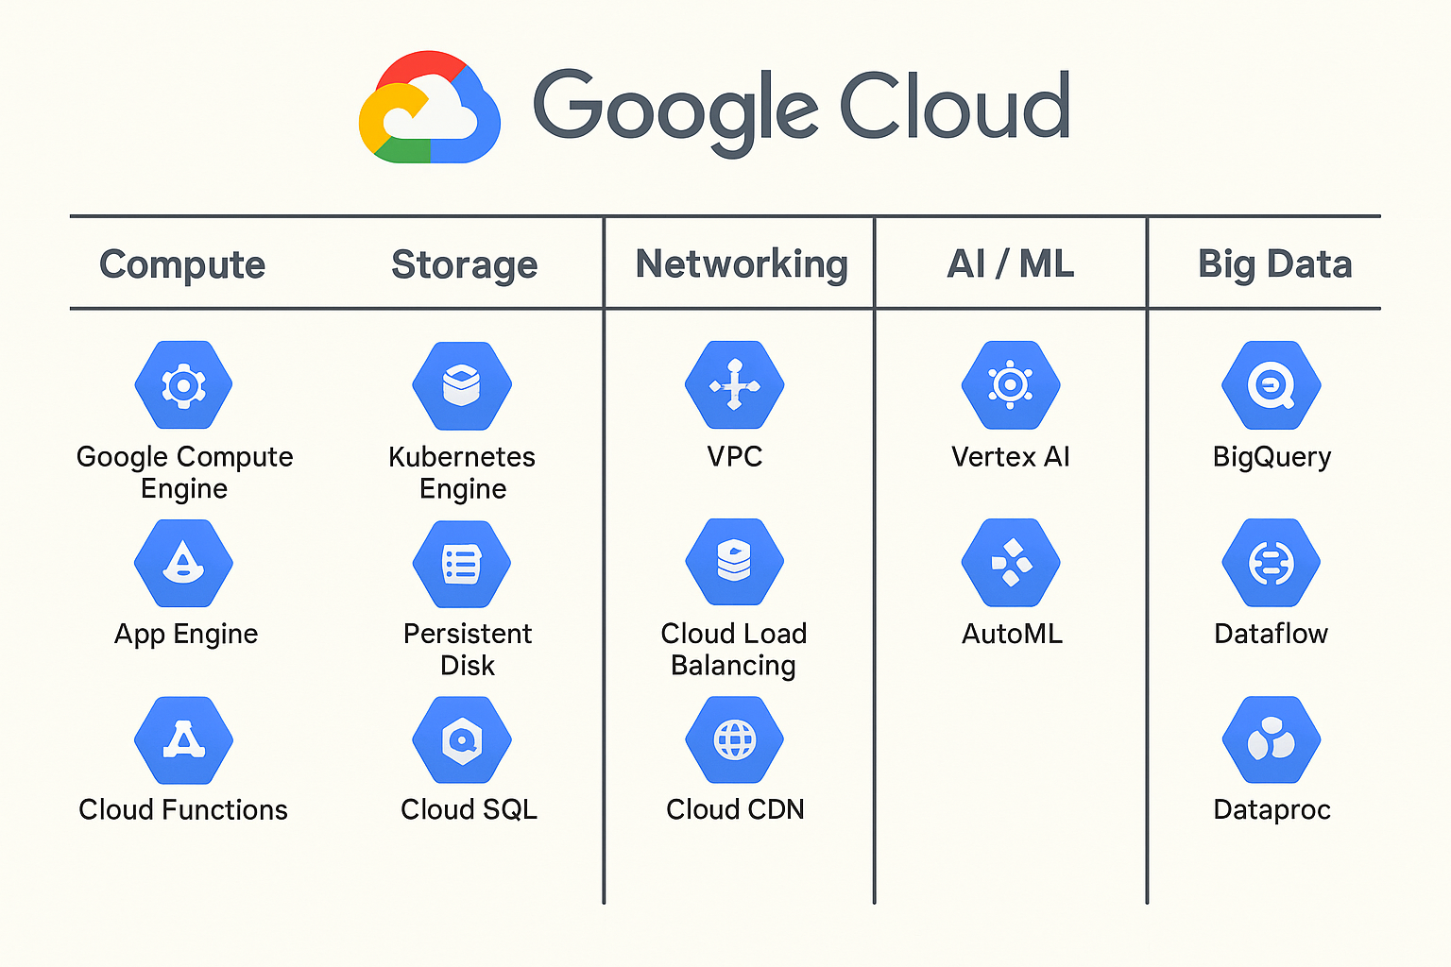
Services

